Slide 1
NURSING MANAGEMENT: PATIENTS WITH GASTRIC AND DUODENAL DISORDERS

Slide 2
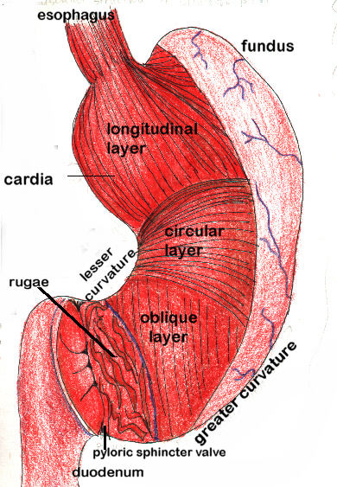
stomach

Slide 3
GASTRITIS
This is inflammation of the gastric or stomach mucosa. May be acute (lasts hrs to days) or chronic.
Causes
Acute gastritis – caused by eating spicy/seasoned foods or foods contaminated with microorganism
Overuse of asprin and other NSAIDs
Ingestion of strong acid or alkali – perforates gastric mucosa

Slide 4
May develop in major traumatic illness, burns, severe infection or major surgery
Chronic gastritis can also be caused by stomach ulcers and H.Pylori
Use of caffeine, alcohol and smoking

Slide 5
Clinical manifestation/Assessment
Rapid onset of abdominal discomfort, headache, nausea, vomiting and hiccupping which can last for a few days
In chronic gastritis – Pt has anorexia, heartburn after eating, belching, sour taste in the mouth, nausea and vomiting
Mild epigastric discomfort
Sometimes associated with achlorhydra or hyperchlorhydria(high level of HCL)
Investigations – Upper GI xray, endoscopy or biopsy of stomach

Slide 6
Nursing Management
The gastric mucosa is capable of repairing itself after a bout of gastritis, Pt recover after 1 day but have diminished apetite
Pt should refrain from alcohol and irritating food until symptoms subside. If patients cannot feed, need to give IVFluids.
If caused by ingesting strong acid or alkali – antacids used to neutralize acid and diluted lemod juice or vinegar used to dilute alkali.(if corrosion is extensive, avoid emesis or lavage because of risk of damage or perforation of the esophagus)

Slide 7
Drugs – analgesics, antacids and IV fluids, Treatment of H.Pylori if it is the cause
Chronic gastritis – Modify diet, reducing stress, avoid alcohol and NSAIDs
Nursing process

Slide 8
PEPTIC ULCER DISEASE
A peptic ulcer may be gastric, duodenal or esophageal depending on location. A peptic ulcer is a hollowed out area that forms in the mucosal wall of the stomach, In the pylorus(opening between stomach and duodenum), in the duodenum or in the esophagus. The ulcer is caused by erosion of the mucus membrane. The erosion may extend deep to the muscle layer or through the muscle to the peritoneum

Slide 9
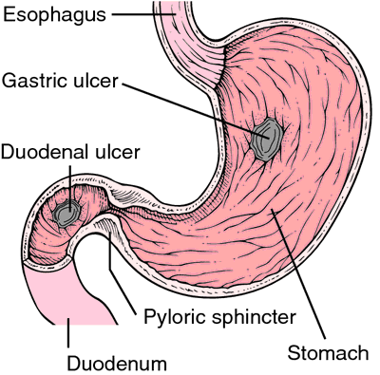

Slide 10
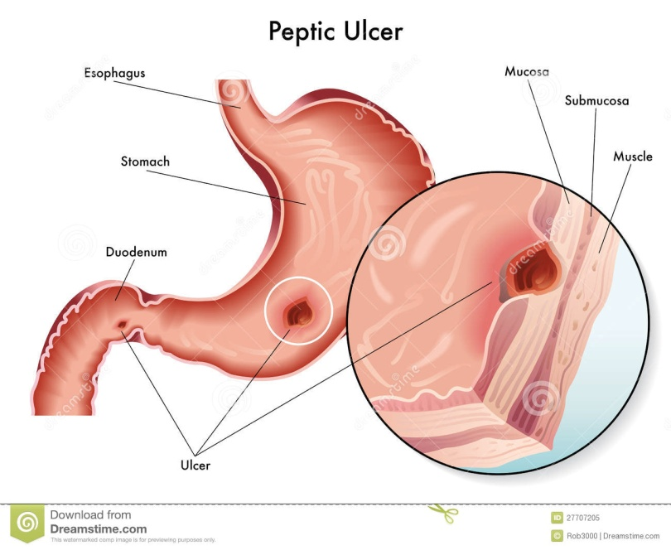

Slide 11
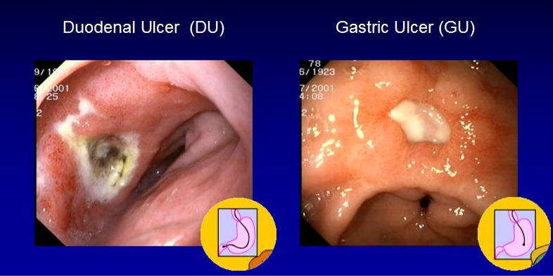

Slide 12
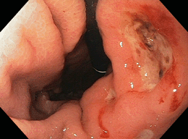

Slide 13
Peptic ulcers are more likely to be in the duodenum than stomach. Mostly occur alone but could be in multiples. S
tomach ulcers tend to occur on the lesser curvature near the stomach.
Esophageal ulcers are a result of backflow of HCL from stomach into the esophagus(GERD)

Slide 14
Features of duodenal ulcers
Duodenal ulcer – 30-60yrs
80% of peptic ulcers are duodenal – Hypersecretion of stomach acid(HCL),
Pain occurs 2-3hrs after meal(awakened 1-2am). Ingestion of food relieves pain. –
Vomiting uncommon.
hemorrhage less likely than with gastric ulcer – melena more common. -More likely to perforate than gastric ulcers
causes -H.pylori, alcohol, smoking, stress

Slide 15
Features of gastric ulcers
Incidence - Less than 50yrs. 15% of peptic ulcers are gastric ulcers
Clinical findings - Normal or hypersecretion of HCL. Pain occurs ½-1hr after meal, rarely awakened at night.
Pain relieved by vomiting, not relieved by ingestion of food(food increases pain). -Vomiting common.
hemorrhage more likely to occur – hematemesis more common than melena
Risk factors - H.pylori, gastritis, alcohol, smoking, NSAIDs use, stress

Slide 16
GASTRIC ULCERS | DUODENAL ULCERS
Sharp pain In the epigastric region 30-60 min after a meal | Burning pain in the epigastric region 2-3 hours after a meal and during the night (wakes the patient at night)
Hematemesis is more common | Melena is more common
Pain increases with ingestion of food | Pain is relieved by ingestion of food

Slide 17
Pathophysiology
PUD mainly occurs in the gastroduodenal mucosa because this tissue cannot stand the digestive action of HCL and pepsin.
How is HCL produced?
Erosion is caused by increased concentration of HCL and Pepsin or by decreased resistance of the mucosa. A damaged mucosa cannot secrete enough mucus to act as a barrier against HCL (NSAIDs inhibit secretion of mucus).

Slide 18
Pts with duodenal ulcers secrete more acid and patients with gastric ulcers secrete normal to reduced acid. Damage to the gastroduodenal mucosa decreases resistance to infection thus infection by H.pylori may occur.
NB – Zollinger Ellison Syndrome (ZES) –It is identified by hypersecretion of gastric acid, duodenal ulcers and gastrinomas – gastrin secreting tumors ). Characterised by multiple ulcers that are resistant to treatment

Slide 19
Stress ulcers/stress gastritis/stress related mucosal disease- This is injury to the lining of the stomach and duodenum during conditions of physiological stress. E.g burns, shock, severe sepsis, multiple organ trauma.. Occurs in 74-100% of critically ill patients in ICU). As the stressful conditions continues, the ulcer spread. Caused by gastric Ischemia.
Cushing ulcer – Caused by head injury/brain trauma and are deeper and more penetrating than stress ulcers
Curling ulcer – occurs 72hrs after extensive burns. Involves antrum of stomach or duodenum

Slide 20
Risk Factors for PUD
Occurs mainly in people between 40-60yrs. Has been observed in children and even infants.
In the past, stress and anxiety were thought to cause PUD but research has revealed that PUDresults from infection with the gram –ve H.Pylori which is acquired from food and water and exposure to emesis. NB - H.Pylori infections are common but do not cause PUD in all people
Excessive secretion of HCL in the stomach contributes to PUD.
.

Slide 21
Stress is associated with increased HCL.
Ingestion of milk, coffe, tea, smoking, alcohol may increase HCL.
Eating spicy foods makes PUD worse
Familial tendancy are also a predisposing factor – people with blood group O more predisposed(genetic link)
Chronic use of NSAIDs is associated with PUD
PUD found in patients with tumors that secrete excess amounts of Gastrin (ZES consists of severe PU, gastric hyperacidity and gastrin secreting bening and malignant tumors of the pancrease)

Slide 22
Assessment of PUD
Symptoms of ulcers may last for a few wks, days or months and may disappear and reappear.
Many people with PUD have no symptoms
History
Pt complains of a dull, gnawing pain or a burning sensation in the mid-epigastrium or the back. The pain occurs when there is increased gastric content in the stomach and duodenum that erodes the lesion and stimulates the exposed nerve endings. Another theory suggests ccontact of the acid with the lesion initiates contraction of adjacent smooth muscles.

Slide 23
Pain is relieved by eating or taking alkali – neutralizes the acid. Once the food/alkali is over, the pain returns
Tenderness of the epigastrium
Pyrosis(heartburn) – Burning sensation in the stomach and esophagus that moves out to the mouth followed by sour burping(when stomach is empty)
Nausea/vomiting, constipation or diarrhea(diet and medication). Patient feels pain and bloating that is relieved by vomiting.
Bleeding – 15% of PUD pts experience this. This is evidenced by passage of melena(tarry stool) or hematemesis, some bleed with no symptoms at all.

Slide 24
Physical exam
Pain, epigastric tenderness or abdominal distention
Investigations
Barium study of the upper GI tract may show an ulcer
Endoscopy – preferred because it allows for direct visualization of ulcers. Through endoscopy, a biopsy of the lesion can be obtained(tested for H.Pylori).
Stool for occult blood
Gastric secretory studies – for achlorhydria and ZES
Test for H.pylori – by examining tissue obtained from endoscopy biopsy or through a rapid serological testing of antibodies against H.Pylori.

Slide 25
Medical Management
Once the diagnosis is established, the pt should be informed that the condition can be managed although it can recur.
PUD treated with antibiotics to eradicate H.Pylori has lower recurrence rate
Management goals are to eradicate H.Pylori and manage gastric acidity. Methods used are:

Slide 26
Pharmacologic Therapy
Current therapy is a combination of antibiotics, proton-pump inhibitors(PPIs) and Bismuth salts that suppress H.Pylori. Reccommended therapy is 10-14 days triple therapy composed of 2 antibiotics(Metronidazole/Amoxil, Clarithromycin and a PPI(omeprazole/Lansoprazole)(quadruple therapy adds Bismuth salt). Current research on a vaccine
H2 receptor antagonists and PPIs are used to treat NSAID induced ulcers (PUD not caused by h.Pylori)

Slide 27
Pt is adviced to complete and adhere to the treatment regime to ensure complete uninterrupted healing of the ulcer and to prevent recurrence. This is because the symptoms disappear after 1 week of treatment. Mantainance dose of H2 receptor antagonists is recommended for 1 yr.

Slide 28
Rest, sedatives and traquilizers may be added as needed

Slide 29
Pts at risk of stress ulcers – Pts with burns or head injury are treated prophylactically with IV H2 antagonists and cytoprotective agents(Misoprostol and sucralfate)
Stress reduction and Rest
Reducing stress requires physical and psychological modification on the patient as well as cooperation of family members. Help pt identify situations that are stressful and exhausting. Hectic lifestyle and irregular schedules may aggravate symptoms. Pt needs rest and relaxation and behavior modification

Slide 30
Smoking Cessation
Studies show that smoking decreases the secretion of bicarbonate from the pancrease into duodenum causing hyperacidity of the duodenum. Smoking inhibits ulcer repair thus Pt adviced to stop smoking

Slide 31
Dietary Modification
The goal of diet modification is to avoid oversecretion of gastric acid and hypermotility in the GIT. This is avoided by:
Avoiding extremes of temperature of food and beverages
Avoid meats,alcohol, coffee(including decaffeinated), Tea,milk and cream as they cause overstimulation of HCL production

Slide 32
Eat 3 regular meals a day to neutralize gastric acid. Small frequent meals not necessary as long as an antacid or histamine blocker is taken
Eat foods that are tolerated and avoid those that produce pain

Slide 33
Surgery
Indicated for patients with intractable ulcers(those that fail to heal), life threatening hemorrhage, perforation, obstruction and ZES unresponsive to Rx.Surgical procedures include vagotomy and antrectomy.
Follow up Care
Recurrence of PUD within 1 yr may be prevented by prophylactic use of H2 antagonists. Mantainance therapy may be prescribed for those with recurrence 2-3times/yr, those with bleeding and Gastric outlet obstruction (GOO) and those who need surgery. The drugs are combined with diet and lifestyle modification.

Slide 34
Monitoring and Managing Potential Complications
Hemorrhage
Gastritis and hemorrhage from PUD are the most common causes of upper GI bleeding. Hemorrhage occurs in 30-60% of patients with PUD. It manifests as hematemesis or melena. Vomited blood can be bright red or it can have a dark coffee grounds appearance(oxidation of hemoglobin to methemoglobin. When hemorrhage is large 2-3L, most of the blood is vomited, because lardge quantities of blood is lost quickly, immediate correction of blood loss is required to prevent hemorrhagic shock

Slide 35
When hemorrhage is small, most of the blood is passed in stool which appears tarry black because of digested hemoglobin. Mx depends on amount of blood loss and rate of bleeding.
Nurse should assess pt for fainting or dizziness and nausea that accompanies bleeding. Monitor vitals to evaluate hypotension, tachycardia and tachypnea. Also need to monitor Hb, stool for occult blood and urine output( detect oliguria/anuria). Mental confusion and thirst

Slide 36
The cause and severity of hemorrhage must be identified quickly and treated to prevent hemorrhagic shock
If bleeding cannot be managed by medical therapy - gastric lavage, endoscopic coagulation by laser can be used.
How soon should endoscopy be performed after hemorrhage? – within 24hrs after hemorrhage has stabilized(blood decreases visibility). If bleeding reoccurs, this warrants surgery. In surgery, the area of ulcer is removed and bleeding vessel ligated

Slide 37
2. Perforation and Penetration
Perforation is erosion of the ulcer through the gastric serosa into the peritoneal cavity without warning. It is an emergency that requires immediate surgery. Penetration is erosion of the ulcer through the gastric serosa to adjacent structures such as pancrease, biliary tract and peritoneum
Chemical peritonitis developes within few hrs followed by bacterial peritonitis. The perforation must be closed as quickly as possible and abdominal cavity lavaged of stomach and intestinal contents.

Slide 38
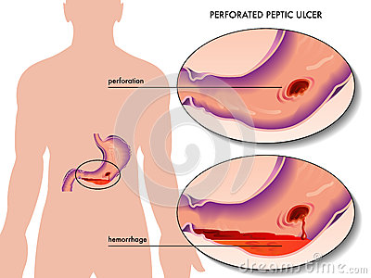

Slide 39
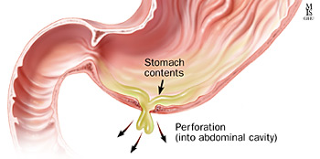

Slide 40
During surgery and post op, stomach contents are drained by NGT. Pt is monitored for fluid and electrolyte balance and signs of peritonitis(fever, abdominal pain, distention, increased or absent bowel sounds)
Signs of perforation include – Sudden upper abdominal pain increasing in intensity, pain may be referred to the shoulder, vomiting, fainting, tender and rigid(board like) abdomen, signs of shock – hypotension and high BP).

Slide 41
3. Pyloric Obstruction
Also referred to as gastric outlet obstruction. Occurs when the area distal to pyloric sphincter becomes scarred and stenosed from edema and scar tissue when the ulcer heals. Pt has nausea, vomiting, constipation, epigastric fullness, anorexia, wt. loss.
First priority is to insert an NGT to decompress the stomach – aspirated residual of more than 400ml suggests obstruction
Upper GI endoscopy also confirms pyloric obstruction. Decompression and managing fluid and electrolyte improve pts conditon. If pt is not relieved, surgery may be required

Slide 42
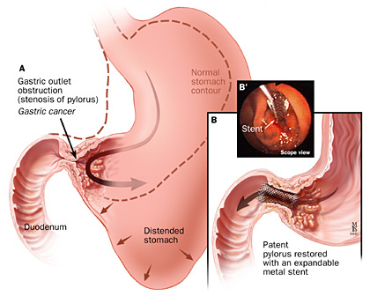

Slide 43
Assignment –
Make a nursing care plan for a patient with peptic ulcer disease
.

Slide 44
GASTRIC SURGERY
Performed on patients with PUD who have life threatening hemorrhage, obstruction and perforation.
performed also in patients with gastric cancer or trauma.
Procedures involve vagotomy – (transecting nerves that stimulate acid secretion), pyroplasty (opening of pylorus) or total or partial gastrectomy.

Slide 45
Nursing Process for Patient undergoing Gastric Surgery
Assessment
Before surgery assess family knowledge on reason for surgery and pre and post surgery procedures
Assess pts. Nutritional status and weight loss – (5% wt loss in 30 days or 7.5% wt loss in 90 days has greater risks) – Anaemic – Hb, hydration status, LFTs – proteins and albumin, Wasting
Assess for nausea, vomiting, hematemesis, bowel sounds, abdominal masses and tenderness.

Slide 46
After surgery, the nurse assesses patients for complications of abdominal surgery such as:
hemorrhage,
infection
bdominal distention,
atelectasis ( respiratory distress)
impaired nutritional status due to inability to take adequate food

Slide 47
Nursing Diagnosis
Anxiety related to surgical intervention – Goal is to reduce anxiety
Acute pain related to surgical incision – Relieve of pain
Knowledge deficit about the surgery and post operative care – increase knowledge and understanding and enhance self care skills
Imbalanced nutrition, less than body requirements due to poor nutrition before surgery and altered GI system after surgery – Goal is optimal nutrition and Mx of complications that interfere with nutrition

Slide 48
Nursing Intervention
Reducing Anxiety – encourage pt to verbalize concerns and answer the family questions. In an emergency(acute perforation or hemorrhage) , the nurse may address this after surgery.
Relieve pain – analgesics given to relieve pain and discomfort after surgery and enable pt perform pulmonary care activities (deep breathing and coughing), leg exersices, turning and ambulate. Monitor effects of analgesia, position pt in fowlers position for comfort and to promote gastric emptying.

Slide 49
The nurse maintains an NGT to prevent distention and ensure it is well secured to prevent dislocation. Also monitors NGT drainage(usually minimal)
Providing teaching – teach pt on pre and post op procedures, Medications, NGT, IV fluids, Abdominal Dressings, Pain management and pulmonary care

Slide 50
Resuming enteral intake – Nutritional status is evaluated before surgery( mostly pts are malnourished especially in gastric Cancer) and may require pre op parenteral feeds. After surgery, Pt is NPO and is continued on parenteral feeds for calories, fluid and electrolyte replacement until oral intake is resumed.
After return of bowel sounds and removal of NGT, pt is first given fluids(oral sips) followed by food in small portions. It is gradually added until pt can feed on 6 small meals a day and drink 120ml fluid between meals.( gradually offer food and fluids as tolerated because pts are different)

Slide 51
Recognize obstacles to adequate nutrition
Dysphagia and gastric distention – Injury to esophagus, nausea, vomiting, abdominal distention, regurgitation. Distention and vomiting may disrupt sutures. Need to reinstate NPO and NGT suctioning
Bile Reflux –May occur with removal of pylorus leading to bile in the stomach (gastritis) and esophagus(esophagitis). Causes epigastric pain and vomiting of bilous material. Agents that bind to bile(cholestyramine) are helpful. Antacids and metoclopramide also used.

Slide 52
3. Dumping Syndrome – foods high in CHO and electrolytes must be diluted in jejunum before absorption can take place. In enteral feeding(NGT), food passes too quickly for this process to occur. The hypertonic intestinal contents draw water from circulating blood into the jejunum to dilute the sugars and electrolytes. (Ingestion of fluids with meals also causes food to move too quickly to the jejunum). SYMPTOMS are fullness, weakness, dizziness and fainting, palpitation, diaphoresis, cramping, pain and diarrhea. They resolve once the intestine is emptied

Slide 53
Cont. dumping syndrome
. Later, there is rapid elevation of blood glucose and increased insulin leading to hypoglycemia - ( headache, palpitation, perspiration, dizzy, drowsy in 10-90min after eating).
Pt may be reluctant to eat.
Steatorrhea (excess fat in feces)

Slide 54
4. Vitamin and mineral deficiency –
after surgery, there is malabsorption of iron( supplement with oral or parenteral iron).
There is also a low serum level of vitamin B 12 which may be supplemented by IM route(Gastrectomy leads to lack of intrinsic factor required for absorption of B12 from the GIT. If not supplemented, pt suffers from B12 deficiency that leads to pernicious anaemia. B12 given monthly via IM route soon after surgery).
Pts. Tend to have wt. loss due to reduced appetite and early fullness

Slide 55
5. Monitoring and managing potential complications
Monitor for hemorrhage( signs of shock or bright red blood in vomiting, assess NGT drainage type and amount, assess abdominal dressing for hemorrhage. Emergency measures are NGT lavage, Administering blood &products and hemodynamic monitoring.
5. Teaching patients selfcare
Provide information on nutrition, diet, pain mx and complications. Involve also the members of Health care team and family in the discharge plan. Also link with community services and support groups

Slide 56
Write Up Assignment
Develop a patient teaching plan on for a patient who has undergone gastric surgery
Include goals of teaching and specific messages to provide(refer to patient teaching template)
Refer to medical- surgical nursing books
Submit your write up next week on the first GIT lesson

Slide 57
NURSING MANAGEMENT: PATIENTS WITH INTESTINAL AND RECTAL DISORDERS

Slide 58
CONSTIPATION
Constipation can be defined as:
Infrequent or irregular defecation (normal bowel movement – 3/day to 3 times a week)
Abnormal hardening of stool that makes their passage difficult and sometimes painful
Retention of stool in the rectum for a prolonged period often with a sense of incomplete evacuation after defecation

Slide 59
Causes of constipation
Medications – traquillizers, anticholinergic drugs, antihypertensives, diuretics, alumionium antacids, opioids, iron preparations, muscle relaxants, antidepressants, bile sequestrants
Rectal and anal disorders – hemorrhoids, fissures
Obstruction – Bowel tumors
Metabolic,endocrine, neurologic, neuromuscular disease e.g hirschsprung disease, hypothyroidism
Colon diseases – irritable bowel disease, diverticula
Immobility – weakness, disability, fatigue and inability to increase intrabdominal pressure to facilitate passage of stool e.g spinal injury

Slide 60
Dietary habits – low fiber (Fiber increases bulk of stool easing movement. Also promotes optimal fermentation providing good bowel wall health) and fluid intake
Lifestyle – lack of exersice and stress
Ignoring the urge to defecate – rectal mucosa and muscles become insensitive to fecal masses and a stronger urge is required to stimulate defecation. After some time, the colon looses muscle tone and becomes unresponsive to stimulus( like an overstretched balloon)
Chronic laxative use

Slide 61
Pathophysiology of constipation
Constipation occurs due to interference with one of the 3 major functions of the colon:
Mucosal transport( mucosal secretions facilitate movement of contents)
Mixing of the rectal mass and propulsive action
Process of defecation – Pelvic floor dysfunction
The urge to defecate is stimulated by distention of the rectum that leads to 4 actions – stimulation of the rectoanal reflex, relaxation of the internal and external sphincter muscle, relaxation of pelvic muscles and increase in intrabdominal pressure. Interference with above leads to constipation

Slide 62
Clinical Manifestation
Fewer than 3 bowel movements per week
Abdominal distention, pain and pressure
Decreased apetite
Indigestion
A sense of incomplete evacuation
Straining at stool
Elimination of small volume, lumpy, hard, dry stool
Headache and fatigue
chronic constipation – symptoms present for at least 12 weeks

Slide 63
Assessment and diagnostic findings
History and physical exam – onset, duration of constipation,bowel elimination patterns, lifestyle –exersice diet, stress, medication and laxative use history, abdominal pain and straining experience
Barium enema, sigmoidoscopy and stool for occult blood – These tests determine if symptoms are due to narrowing of the bowel.

Slide 64
Complications of constipation
Hypertension – increased arterial pressure occurs with defecation, straining at stool which results in valsava maneuver( forcibly exhaling with glossitis closed) markedly elevates BP.Pressure first drops due to increased thoracic pressure during straining that collapses the veins leading to decreased cardiac output and decreased BP. Immediately after BP increases due to compensatory reactions and in hypertensive pt, it may cause rapture of major vessels in the brain or elsewhere.

Slide 65
Fecal impaction – occurs when accumulated mass of dry feces cannot be expelled. The mass may be palpable on digital exam. The mass may put pressure on colon mucosa resulting in ulcer formation and frequently causes seepage of liquid stool.
Hemorrhoids – due to perianal vascular congestion caused by straining and anal fissures (tissue folds)– due to passage of hard stool through the anus tearing the lining of the anal canal

Slide 66
Mega-colon – Dilated and atonic colon caused by a fecal mass that obstructs passage of colon contents. It is characterized by incontinence, liquid fecal incontinence and abdominal distention. Can cause perforation of the bowel
NB – Gerontologic considerations – Most people above 60yrs complain of straining during passing stool. This is due to difficulty chewing (lost teeth) thus tend to eat soft foods low in fibre. Also they tend to have decreased food intake,decreased fluid intake, reduced mobility, bed rest and weak abdominal muscles. They also tend to have some chronic illness requiring multiple medications that may cause constipation.

Slide 67
Medical Management
Identify Underlying cause of constipation
Education – education and health promotion are important. Includes setting teaching goals from the health history e.g . adequate fluid intake, restoring or maintaining a regular pattern of defecation by responding to the urge to defecate, exersice, avoid long term abuse of laxatives, adequate fluid intake, high fiber foods, avoiding complications, abdominal toning exersices
Bowel habit training – routine exersice
Increase fibre and fluid intake

Slide 68
Judicious use of laxatives – Bulk forming, osmotic agents, lubricants, stimulants, stool softeners (can be combined)
Treatment of fecal impaction – digital dislodgement, enemas and rectal suppositories, long term laxatives (Only used for impaction – are embarrassing and painful)
Medications to increase colon transit(propulsion) – cholinergic drugs e.g bethanecol, prokinetic drugs e.g metoclopramide
Nursing process in management of constipation and health teaching plan

Slide 69
DIARRHOEA
It is Increased frequency of bowel movements( more than 3/day), an increased amount of stool(more than 200g/day) and altered consistency( more liquid) of stool. It is associated with urgency, perianal discomfort and incontinence.
Causes of diarrhea
Any condition that causes increased intestinal secretions, decreased mucosal absorption or altered motility can produce diarrhea. They Include

Slide 70
Acute diarrhea most often associated with infections and is usually self limiting – 7-14days (chronic diarrhea lasts for more than 2 -3weeks) – viral(rotavirus) or bacterial – shigella, salmonella food poisoning, cholera
Medications – thyroid hormone replacement, laxatives, prokinetic drugs, antibiotics, anticancer drugs, Mg antacids, tube feeding formulas, endocrine disorders – addisons, thyrotoxicosis
GIT conditions – irritable bowel syndrome, inflammatory bowel Dx, Lactose intolerance
Anal sphincter defects, Malabsorptive disorders(Celiac disease), AIDS – chronic diarrhoea

Slide 71
Pathophysiology of diarrhea
There are 5 types of diarrhea:
Secretory diarrrhoea – high volume diarrhea associated with bacterial toxins. Caused by increased production and secretion of water and electrolytes by the intestinal mucosa into the intestinal lumen.
Osmotic diarroea – Occurs when water is pulled into the intestines by osmotic pressure of unabsorbed particles. This slows reabsorption of water. E.g. lactose intolerance or intestinal hemorrhage

Slide 72
Infectious diarrhea – results from infectious agent invading the intestinal mucosa e.g clostridium deficile causes antibiotic associated diarrhea in hospitals
Exudative diarrhea – Caused by changes in mucosal integrity or tissue destruction by radiation or chemotherapy

Slide 73
Clinical manifestation
Increased frequency and fluid content of stool
Abdominal cramps, distention, intestinal rambling(borborygmus), anorexia and thirst
Painful spasmodic contractions of the anus and ineffective straining(tenesmus) may occur with defecation
Symptoms related to dehydration and fluid and electrolyte imbalance

Slide 74
watery stool – characteristic of small bowel disorder, semi-solid stool – large bowel, voluminous greasy stool – malabsorption, blood,mucus,pus in stool – inflammatory enteritis or colitis, oil droplets in stool – pancreatic insufficiency)
Diagnostic tests – CBC, stool examination and culture, chemistries and barium enema

Slide 75
Complications of Diarrhoea
Fluid loss – dehydration – reduced blood flow in major organs – brain, kidneys(reduced urine output - ARF), heart( reduced CO –reduced BP - shock)
Electrolyte imbalance – low potassium levels lead to dysrrhythmias, Nerve transmission is interfered with – paresthesia and muscle weakness
Skin care issues – Dermatitis – Prevented by keeping skin dry and applying barrier cream

Slide 76
Management of Diarrhoea
Goal – control symptoms, prevent complications and treat underlying cause.
Treat underlying cause with medications – Give antibiotics, anti-inflammatory drugs, antidiarrhoeals(Loperamide)
Nursing assessment – Assess and monitor characteristics of the diarrhea – health history – medication used, diet patterns, recent travel. Physical exam – abdominal palpation and auscultation and assessment of hydration status(abdomen, skin, mucus membranes), also assess perianal area.

Slide 77
Fluid replacement – Bedrest, increased fluid intake, foods low in bulk until the acute attack subsides. Pt should avoid caffeine, carbonated drinks, very hot or very cold foods as they stimulate motility. Restrict milk, fat, fresh fruits and vegetables for several days. Also administer antidiarrhoeal medication and monitor the stool. ORS can be administered if patient is not drinking enough. IVF may be necessary for rapid dehydration(Hartmanns/RL). Coninue to assess for hydration status
Manage electrolyte imbalance – Monitor K levels(serum K), Dysrrhythmias, replace lost electrolytes. Monitor muscle weakness and nerves

Slide 78
Monitor complications of brain, kidney heart(BP)
Manage Perianal region – perianal care to decrease irritation and excoriation. (older people skin has decreased turgor and decreased subcutaneous layer)
Nursing care plan for a patient with diarrhoea

Slide 79
FECAL INCONTINENCE
Fecal incontinence is involuntary passage of stool from the rectum. Factors that influence fecal continence include:
Ability of rectum to sense and accommodate stool
Amount and consistency of stool
Integrity of anal sphincter and muscles
Rectal motility

Slide 80
Causes
After rectal surgery
Neurological disorders – paralysis or stroke
Infection/inflammation of the rectum
Chemotherapy and radioptherapy
Pelvic floor relaxation
Laxatives and medications
Fecal impaction
Old age – loss of rectal or anal muscle tone

Slide 81
Clinical manifestation
Minor soiling, occasional urgency, loss of control, complete incontinence. May have poor control of flatus or diarrhea

Slide 82
Management
NB – Condition is embarrassing and socially incapacitating
If due to diarrhea – manage the diarrhea
If due to fecal impaction – normal function resumes after impaction is cleared
Pelvic muscle training/bowel training(planned/scheduled elimination) – if due to decreased sensory awareness or sphincter control.
Biofeedback – improves sphincter contractility and rectal sensitivity.
Use diet and fiber to improve continence

Slide 83
Maintain perineal skin integrity – change diapers often especially in elderly. Teach skin hygiene and use skin protection products
Help pt and family cope If incontinence is chronic – external collection devices, Fecal management systems
Surgery – artificial sphincter, sphincter repair or fecal diversion

Slide 84
IRRITABLE BOWEL SYNDROME(IBS)
This is signs and symptoms caused by changes in intestinal motility without anatomic or biochemical abnormalities. It is associated with Heredity, Psychological stress, depression and anxiety, Diet high in fat and irritating foods, Alcohol and smoking. Peristaltic waves are affected in a segment of the intestine. It occurs without inflammation of the intestinal mucosa.

Slide 85
Clinical manifestation
Alteration in bowel patterns – constipation, diarrhea or combination. Pain, bloating, abdominal distention. Pain precipitated by eating and relieved by defecation sometimes.
Medical management
Relieve abdominal pain
Relieve constipation or diarrhoes
Reduce stress/ antidepressants
Restrict irritating foods

Slide 86
High fiber diet and exersice to increase motility
Anticholinergics can decrease cramping and constipation
Probiotics (lactobacillus, bifidobacterium) – Decrease bloating and gas
Educate pt on good dietary habits – avoid irritating foods, high fiber. Can keep a food diary to help identify problem foods. Avoid alcohol and cigarette smoking and stress management.

Slide 87


